Slide 1
Cloud Computing Essentials with OpenStack Introduction and
Unix Review
Farhan Patwa
The Institute of Cyber Security

Slide 2
Cloud Computing Essentials - Overview
Cloud Computing is the use of computing resources that are delivered as a service over the network.
A cloud is a powerful combination of cloud computing, networking, storage, management solutions, and business applications that facilitate a new generation of IT and consumer services.
These services are available on demand and are delivered economically without compromising security or functionality._x0016__x0016_

Slide 3
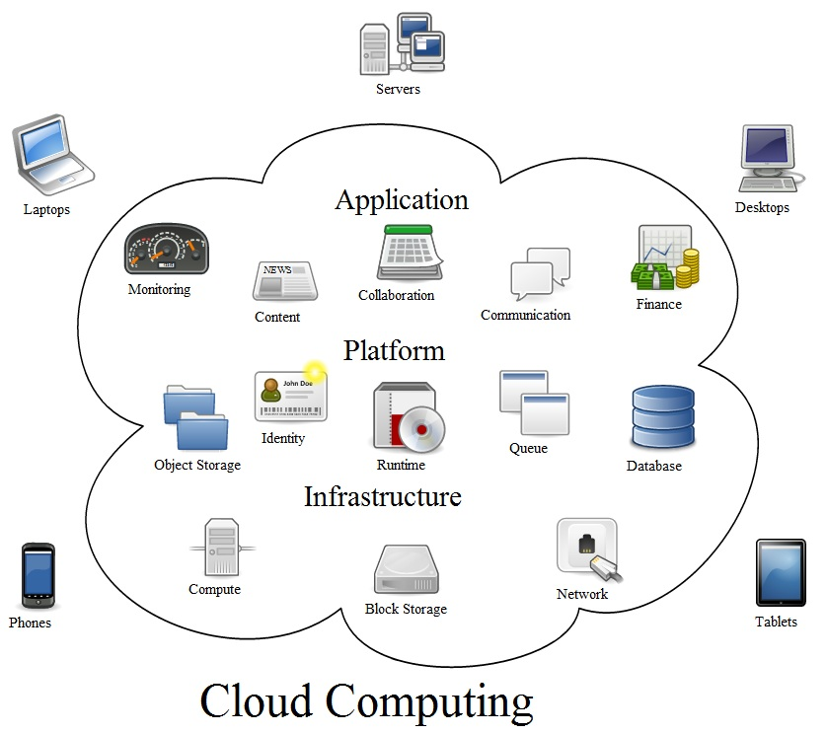

Slide 4
History of Cloud Computing
In 1950s and 1960s, costly large-scale mainframe became available, allowing multiple users sharing CPU
Cloud symbol was used to represent the Internet as early as 1994
Amazon Web Service (AWS) in 2006
Eucalyptus: first open-source AWS API-compatible platform in 2008
OpenStack: Rackspace and NASA in 2010
Google Compute Engine: Google in 2012
IBM, HP, Citrix, VMWare, etc.

Slide 5
Cloud computing vs. traditional IT
Virtualization: the ability to increase computing efficiency
Democratization of computing: bringing enterprise scale infrastructure to small and medium businesses
Scalability and fast provisioning: bringing web scale IT at a rapid pace
Commoditization of infrastructure: enabling IT to focus on the strategic aspects of its role

Slide 6
The economics of cloud computing
Lowering the opportunity cost of running technology
Allowing for a shift from capital expenditure to operating expenditure
Lowering the Total Cost of Ownership (TCO) of technology
Giving organizations the ability to add business value by renewed focus on core activities

Slide 7

Cloud computing stack
Notes:
1. SaaS applications are designed for end-users, delivered over the web
2. PaaS is the set of tools and services designed to make coding and deploying those applications quick and efficient
3. IaaS is the hardware and software that powers it all – servers, storage, networks, operating systems

Slide 8
Software as a Service (SaaS)
Web access to commercial software
Software is managed from a central location
Software delivered in a “one to many” model
Users not required to handle software upgrades and patches
Application Programming Interfaces (APIs) allow for integration between different pieces of software

Slide 9
Platform as a Service (PaaS)
Services to develop, test, deploy, host and maintain applications in the same integrated development environment
Web based user interface creation tools help to create, modify, test and deploy different UI scenarios
Multi-tenant architecture where multiple concurrent users utilize the same development application
Built in scalability of deployed software including load balancing and failover
Integration with web services and databases via common standards
Support for development team collaboration
Tools to handle billing and subscription management

Slide 10
Infrastructure as a Service (IaaS)
Resources are distributed as a service
Allows for dynamic scaling
Has a variable cost, utility pricing model
Generally includes multiple users on a single piece of hardware

Slide 11

OpenStack Introduction

Slide 12
What is OpenStack?
OpenStack is an IaaS cloud computing project started by Rackspace and NASA in 2010
Who are involved? More than 150 companies
  AMD, Intel, Canonical, SUSE Linux, Red Hat, Cisco, Dell, HP, IBM, Yahoo, Citrix, VMWare, etc.
Purpose of Project OpenStack
  Enable any organization to create and offer cloud computing services running on standard hardware

Slide 13
OpenStack components
Cloud compute (Nova)
Cloud storage (Swift)
Image delivery and registration (Glance)
Identity (Keystone)
Dashboard (Horizon)
Network Connectivity (Neutron)

Slide 14
Release history
Release name | Release date
Austin | Oct. 21, 2010
Bexar | Feb. 3, 2011
Cactus | April 15, 2011
Diablo | Sept. 22, 2011
Essex | April 5, 2012
Folsom | Sept. 27, 2012
Grizzly | April 4, 2013
Havana | Expected on Oct 17, 2013

Slide 15
Github
Github is the best place to share code with friends, co-workers, classmates, and complete strangers.
OpenStack code repositories hosted at Github.
  https://github.com/openstack

Slide 16
OpenStack Wiki
http://wiki.openstack.org/StartingPage

Slide 17
Launchpad
Launchpad is a software collaboration platform that provides bug tracking, code hosting, code reviews, mailing lists, answer tracking and FAQs, etc.
Create an account and be part of the community
https://launchpad.net/openstack

Slide 18
OpenStack IRC channels
#openstack on irc.freenode.net (general discussion, support)
#openstack-dev on irc.freenode.net (development discussion)
#openstack-meeting on irc.freenode.net (team meetings)
#openstack-packaging on irc.freenode.net (packaging discussions)

Slide 19
OpenStack mailing lists
Register for a launchpad account
Join the Nova, Swift, and/or Glance teams
Sign up at https://launchpad.net/~openstack by clicking “Subscribe to mailing list”

Slide 20
Unix Essentials - Review
Shell Environment [bash]
cli* editor [vi]
cli* utilities
  less/more
  head/tail
  cat
  egrep, grep
  tee
  script
  wget
  curl

Slide 21
Shell and bash
What is a shell?
  The shell is a command that reads lines from either a file or the terminal, interprets them, and generally executes other commands.
  It is the program that is running when a user logs into the system.
  The shell implements a language that has flow control constructs, a macro facility that provides a variety of features in addition to data storage, along with built in history and line editing capabilities.
  It incorporates many features to aid interactive use and has the advantage that the interpretative language is common to both interactive and non-interactive use (shell scripts). That is, commands can be typed directly to the running shell or can be put into a file and the file can be executed directly by the shell
What is bash
  bash is an sh-compatible command language interpreter that executes commands read from the standard input or from a file. bash also incorporates useful features from the Korn and C shells (ksh and csh).

Slide 22
Unix shell Environment [bash]
Bash shell Environment
  References
    http://www.linuxdoc.org/HOWTO/Bash-Prog-Intro-HOWTO.html
  [man] manual pages reference – Unix user’s true best friend!
  [cd] change directories
  [pwd] name of current working directory
  [ls] lists the contents of a directory or directories
  [~] home directory for current user
  [.] current directory reference (e.g. ./myfile)
  [..] one directory up – can be stacked (e.g. ../../myfile)
  ssh (SSH client) is a program for logging into a remote machine and for executing commands on a remote machine.
    [ssh keys] ssh keys are stored in the .ssh folder with default file name [id_rsa and id_rsa.pub]. The remote host key is stored in ‘known_hosts’ file in .ssh directory.

Slide 23
Unix shell Environment [bash]
  [env] run a program in a modified environment/display all current user and system variables
  [echo] display a line of text and value of environment variables
  [export] Names of exported shell variables
  [shell login]
    When bash is invoked as an interactive login shell, or as a non-interactive shell with the --login option, it first reads and executes commands from the file /etc/profile, if that file exists. After reading that file, it looks for ~/.bash_profile, ~/.bash_login, and ~/.profile, in that order, and reads and executes commands from the first one that exists and is readable.
    When a login shell exits, bash reads and executes commands from the files ~/.bash_logout and /etc/bash.bash_logout, if the files exists.
    When an interactive shell that is not a login shell is started, bash reads and executes commands from ~/.bashrc.
  [.bashrc] personal initialization file. (executed at startup/login) Set variables, command prompt, formatting etc.

Slide 24
Unix shell Environment [bash]
  [file permissions] Every file in UNIX has an owner user and an owner group. So, for any file in the system, user ‘foo' may have one of the following ownership relations:
    -rw-r--r-- 1 foo bar 491 Oct 8 14:55 myscriptfile
    foo owns the file, i.e. the file's owner is ‘foo'.
    foo is a member of the group that owns the file, i.e. the file's owner group is ‘bar'.
    foo is neither the owner, nor belonging to the group that owns the file
  Every file on the system has associated with it a set of permissions. Permissions tell UNIX what can be done with that file and by whom. There are three things you can (or can't) do with a given file:
    read it, write (modify) it and execute it.
  [u] owner user, [g] owner group, [o] others, [a] all users – [+] set bit, [-] clear bit, [r] read, [w] write, [x] execute

Slide 25
Unix shell environment
    examples:
      chmod g+rwx <filename>
      Bits are set as <abcd>, a is reserved, b, c and d determine the value of the permission (in the order rwx) e.g. 001 means that only execute permissions are set.
      Set the permissions of a file to have rwx for user and r and x for group and others.

Slide 26
Unix shell environment
  Shell Tips
    comand history, via up and down arrows
    Tab auto complete for directory and file names
    CTRL-R history search
    CTRL-L to clear screen
    CTRL-C to abandon current command

Slide 27
Unix shell environment
bash scripts
  The shell is a command interpreter. More than just the insulating layer between the operating system kernel and the user, it's also a fairly powerful programming language. A shell program, called a script, is an easy-to-use tool for building applications by "gluing together" system calls, tools, utilities, and compiled binaries.
  Virtually the entire repertoire of UNIX commands, utilities, and tools is available for invocation by a shell script.
  Internal shell commands, such as testing and loop constructs, lend additional power and flexibility to scripts.

Slide 28
References
A very good beginners guide to Unix
  http://www.ee.surrey.ac.uk/Teaching/Unix/

Slide 29
cli editor
vi/vim
  vi is a fast and powerful editor that is available on almost all Unix systems.
  vi has no menus but instead uses combination of keystrokes in order to accomplish commands.
  vim is an enhanced version of vi. Among some of the additional advanced features included in vim are:
    Multiple windows
    Visual mode
    Tab navigation
    Abbreviations
    Word completion
  Nowadays in most Unix systems , the vi command is automatically linked to vim.

Slide 30
vi/vim
  vi has two modes:
    the command mode and
    the insert mode.
    It is essential that you know which mode you are in at any given point in time. When you are in command mode, letters of the keyboard will be interpreted as commands. When you are in insert mode the same letters of the keyboard will type or edit text.
  vi always starts out in command mode.
  type [i] to enter the insert mode. To leave insert mode and return to the command mode hit the [ESC] key. If you are unsure of which mode you are in hit the [ESC] a couple of times and that will put you back in command mode.
  vi commands in general are:
    case sensitive - lowercase and uppercase command letters do different things
    not displayed on the screen when you type them
    do not require a Return [Enter] after you type the command.

Slide 31
vi/vim
  Some commands which start with a colon [:]. These commands are ex commands which are used by the ex editor. ex is the true editor which lies underneath vi -- in other words, vi is the interface for the ex editor.
Again, the key to learning vi is to keep in mind always the difference between insert-text mode and command mode.
In the latter mode, as its name implies, one issues commands, such as the [:wq] above, which we issue to save the file and exit vi. The characters you type will appear on the screen if you are in insert-text mode, whereas they may not appear on the screen while you are in command mode.
By far the most frequent problem new vi users have is that they forget they are in insert-text mode, and so their commands are not obeyed.
For example, suppose a new user wants to type [:wq], to save the file and exit vi, but he has forgotten to hit the Escape key to terminate insert-text mode. Then the [:wq] will appear on the screen, and will become part of the text of the file-and the [:wq] command will not be obeyed.

Slide 32
vi/vim
An example of editing a file using vi:
$ vi x
at the Unix prompt. Assuming you did not already have a file named x, this command will create one. (If you have tried this example before, x will already exist, and vi will work on it.
If you wish to start the example from scratch, simply remove x first.)
The file will of course initially be empty. Now type the letter [i]
(it stands for "insert-text mode"), and type the following (including hitting the Enter key at the end of each of the three lines):
The quick
Brown
fox will return.
Then hit the Escape key, to end insert-text-mode.
Now save the file and exit vi, by typing [:wq]

Slide 33
vi/vim
You now have a file named x. You can check its contents by typing (at the Unix shell prompt)
$ cat x
which will yield:
The quick
brown
fox will return.
just as expected.
Now let's see how we can use vi again to modify that file. Type
$ vi x
again, and make the following changes.

Slide 34
vi/vim
First, suppose we wish to say the fox will not return: We need to first move the cursor to the word "return". To do this, type ”/re” and hit the Enter key, which instructs vi to move the cursor to the first instance of ”/re” relative to the current cursor position. (Note that typing only ”/r” would have moved the cursor to the first instance of “r”, which would be the “r” in “brown”, not what we want.)
Now use the [i] command again: Hit [i], then type not (note the space), and then hit Escape.
Next, let's delete the word `brown'. Type b to move the cursor there, and then hit x five times, to delete each of the five letters in `brown'. (This will still leave us with a blank line. If we did not want this, we could have used the ”dd” command, which would have deleted the entire line.)
Now type [:wq] to save the file and exit vi. Use the more command again to convince yourself that you did indeed modify the file.

Slide 35
vi/vim
  There are several cheat sheets for vi that can help act as a reference when using vi, some of them are:
    http://www.math.ntu.edu.tw/~wwang/mtxcomp2010/cssd2011/download/vi_cheat%20sheet.pdf
    http://www.eec.com/business/vi.html
    A good tutorial: http://www.ccsf.edu/Pub/Fac/vi.html
    Newbie tutorial: http://newbiedoc.sourceforge.net/text_editing/vim.html.en
    Official vim doc: http://vimdoc.sourceforge.net/

Slide 36
cli utilities
less/more
head/tail
cat
egrep, grep
tee
script
wget
curl

Slide 37
less is more than more!
more
  more is a filter for paging through text one screen-ful at a time.
less
  less is a program similar to more, but which allows backward movement in the file as well as forward movement.
  Also, less does not have to read the entire input file before starting, so with large input files it starts up faster than text editors like vi

Slide 38
head and tail
head
  The "head" command is used to show the beginning of a text file. By default it prints out the first 10 lines.
  [-n] to specify the number of lines of output desired (e.g. head –n 20 myfile –> display the first 20 lines of the file)
tail
  The “tail" command is used to show the ending of a text file. By default it prints out the last 10 lines.
  [-n] to specify the number of lines of output desired (e.g. tail –n 20 myfile –> display the last 20 lines of the file)
  [-f] used to follow the output data as the file grows (a common term is to ‘tail’ a log file)

Slide 39
cat and grep
cat
  concatenate files and print on the standard output
  Prints out the entire contents of the file ( a common term is ‘cat’ a file)
grep/egrep
  The grep command searches the given file for lines containing a match to the given strings or words. By default, grep displays the matching lines.
  Use grep to search for lines of text that match one or many regular expressions, and outputs only the matching lines.
  examples
    grep “Hello” myProgram.c
    grep -e program -e print myProgram.c
    grep -n "\/\*" myProgram.c
    grep –A 2 “\/\*” myProgram.c
[|] pipe - The standard output of command is connected via a pipe to the standard input of command2. (e.g. ls * |grep myfilename)

Slide 40
tee and script
tee
  read from standard input and write to standard output and files
  great tool to redirect (store) results in a file and see them on standard out at the same time
  Use [-a] option to tee results in appending input to the files.
  examples
    date | tee file1 file2
      October 5, 2012 09:48:10 PM UTC
    cat file1
      October 5, 2012 09:48:10 PM UTC
    cat file2
      October 5, 2012 09:48:10 PM UTC

Slide 41
script
script is a tool that will record/save everything printed on the terminal to a file.
Example:
  [root@unix-essentials ~]# script myscriptfile
  Script started, file is myscriptfile
  [root@unix-essentials ~]# echo "Hello World"
  Hello World
  [root@unix-essentials ~]# date
  October 8, 2012 02:54:46 PM UTC
  [root@unix-essentials ~]# ls
  a.out file1 file2 hm.out mybashScript.sh myProgram.c myProgram.o myscriptfile
  [root@unix-essentials ~]# exit
  exit
  Script done, file is myscriptfile

Slide 42
script
  [root@unix-essentials ~]# cat myscriptfile
  Script started on October 8, 2012 02:54:29 PM UTC
  [root@unix-essentials ~]# echo "Hello World"
  Hello World
  [root@unix-essentials ~]# date
  October 8, 2012 02:54:46 PM UTC
  [root@unix-essentials ~]# ls
  a.out file1 file2 hm.out mybashScript.sh myProgram.c myProgram.o myscriptfile
  [root@unix-essentials ~]# exit
  exit
  script done on October 8, 2012 02:55:23 PM UTC

Slide 43
wget and curl
wget is a tool for retrieving files using HTTP, HTTPS and FTP
  It is a non-interactive command line tool, so it may easily be called from scripts, cron jobs, and terminals.
  wget can follow links in HTML, XHTML, and CSS pages, to create local versions of remote web sites, fully recreating the directory structure of the original site. This is sometimes referred to as "recursive downloading."
  Example:
    wget ftp://ftp.vim.org/pub/vim/extra/vim-7.2-lang.tar.gz

Slide 44
curl
curl is a tool to transfer data from or to a server using one of the supported protocols
curl offers a busload of useful tricks like proxy support, user authentication, FTP upload, HTTP post, SSL connections, cookies, file transfer resume, Metalink, and more. As you will see below, the number of features will make your head spin!
The result of the curl command can be saved to a file by using -o/-O option
  -o (lowercase o) the result will be saved in the filename provided in the command line
  -O (uppercase O) the filename in the URL will be taken and it will be used as the filename to store the result
  curl -o mygettext.html http://www.gnu.org/software/gettext/manual/gettext.html
  curl -O http://www.gnu.org/software/gettext/manual/gettext.html

